Slide 1




PROJECT PLANNING for AUTOMATED STUDENT ATTENDANCE SYSTEM USING FINGERPRINT RECOGNITION APPROACH
TASK 1
BLACK COCROACH VLC COMPANY

Slide 2
TEAM STRUCTURE
Sufi Nukman
Project Leader
Siti Nur Syahirah
Designer
Amir Hassan
Tester
Syafiqah Zulkifli
Analyst
Harith Zainudin
Programmer

Slide 3
WORK BREAKDOWN STRUCTURE
LEVEL 1 | LEVEL 2 | LEVEL 3
1. Automated Student Attendance System Using A Fingerprint Recognition | 1.1 Analysis | 1.1.1 Requirement Meetings 1.1.2 Communication with Stakeholder 1.1.3 Document Current System
 | 1.2 Design | 1.2.1 Design Database 1.2.2 Software Design 1.2.3 Interface Design 1.2.4 Specification Design
 | 1.3 Development | 1.3.1 Develop System Module 1.3.2 Integrate System Module 1.3.3 Perform Initial Testing
 | 1.4 Testing | 1.4.1 Perform System Testing 1.4.2 Document Issues Found 1.4.3 Correct Issues Found
 | 1.5 Implementation | 1.5.1 On-Site Installation 1.5.2 Support Plan for the System
 | 1.6 Completion/Maintenance | 1.6.1 System Maintenance 1.6.2 Evaluation

Slide 4
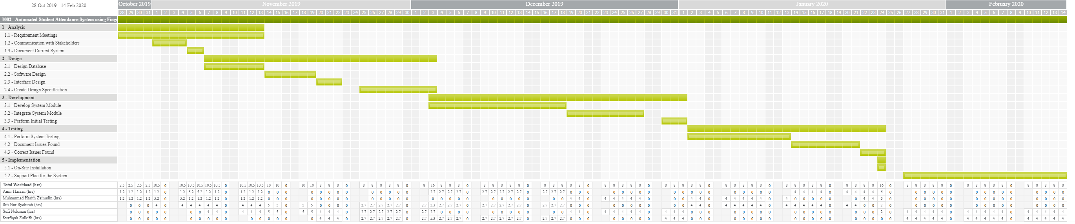
GANTT CHART

Slide 5
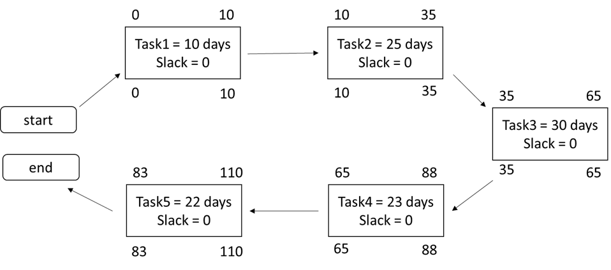
ACTIVITY NETWORK DIAGRAM
Critical Path : T1 → T2 → T3 → T4 → T5

Slide 6
PROWORKFLOW
DEMO

